Slide 1
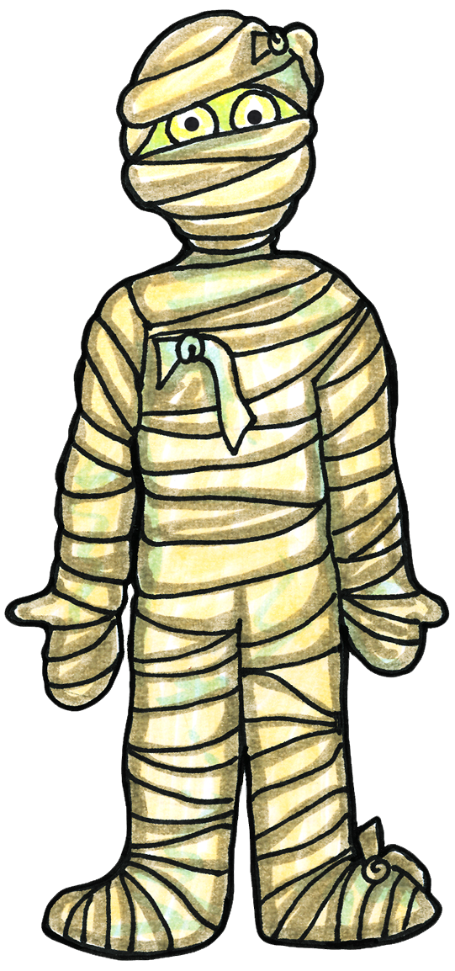
Ancient Egypt is known for its pyramids, but did you know inside the pyramids there was often counter measures to stop grave robbers. They may not have been as elaborate as movies make them out to be…. But for fun lets pretend they were and see if you can make it through to find your treasure.
Click me to get started
To make it through the pyramid you may need to know a few things first so make sure you have read the materials and watched the video or you might never make it out again.... 2 wrong answers in a row and you will end up back at the start.

Slide 2
Oh no! 2 wrong answers in a row… You may need to do some more research before you start again.
Goodluck!
Click me to get started

Slide 3
Click the arrows throughout to choose your path. Your journey will be filled with peril.
Enter at your own risk….

Slide 4
As soon as you walk in you are faced with a long tunnel, your only choice is straight ahead.

Slide 5
Oh no! You fell down a trap door and ended up in this room… I can see a ladder in the corner, or you can keep going straight.

Slide 6
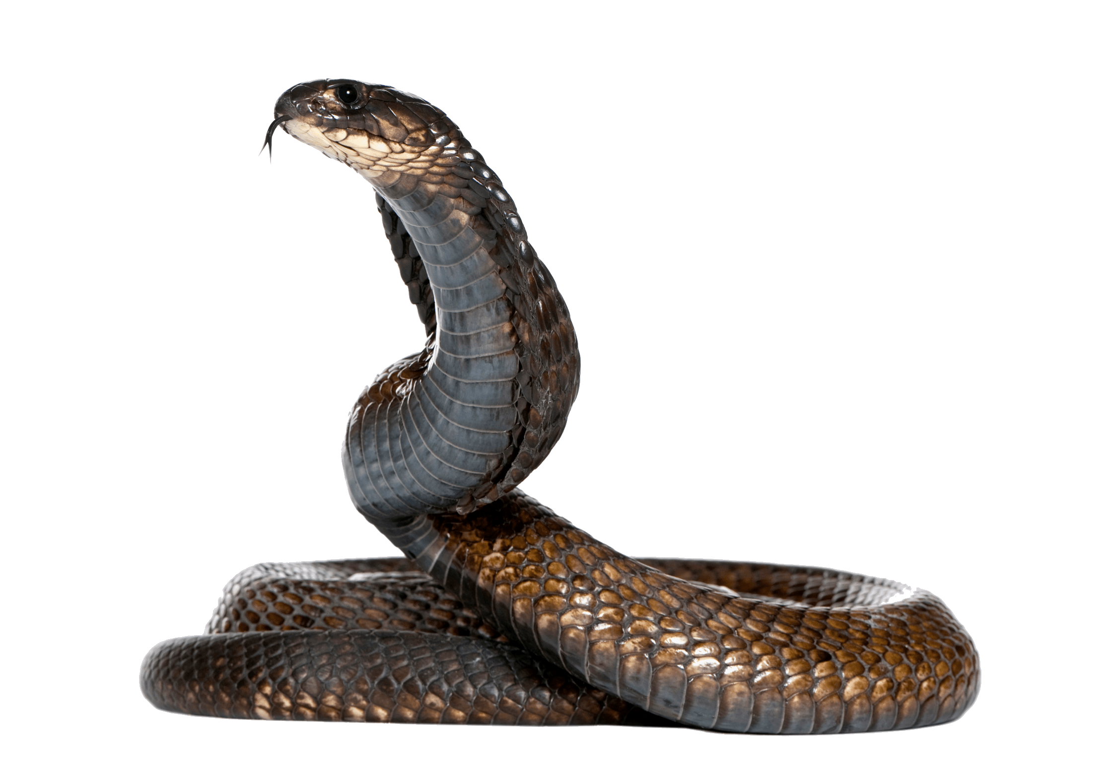
There’s a snake blocking your way! Answer his question correctly and you can move on forward.
If you were among the privileged how long did the mummification process take?
Around 70 Days
Around 20 Days

Slide 7
Oh no you got your question wrong! He is going to give you one more chance…
What happened to the brain during mummification?
It was valuable and was removed carefully, preserved and placed back in the skull.
It had no use and was removed through the nose using a metal hook.

Slide 8
You are back in the tunnel, you can either go back down the ladder, or continue on straight ahead.

Slide 9
Wow this is a pretty amazing room… Looks like a dead end though. You could turn around and go back? Or maybe we can have a look near the statue and see what we can find.

Slide 10
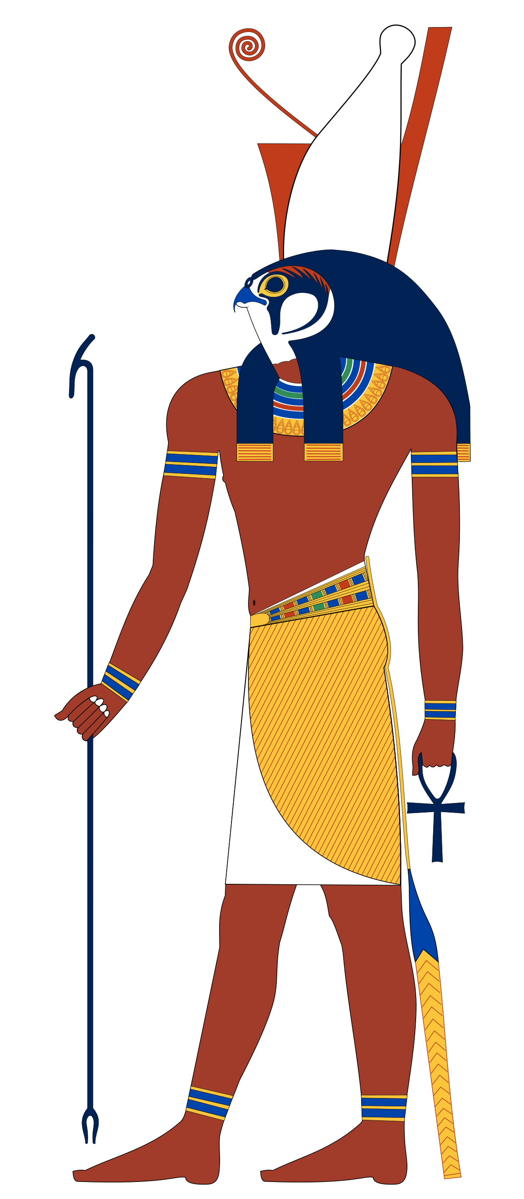
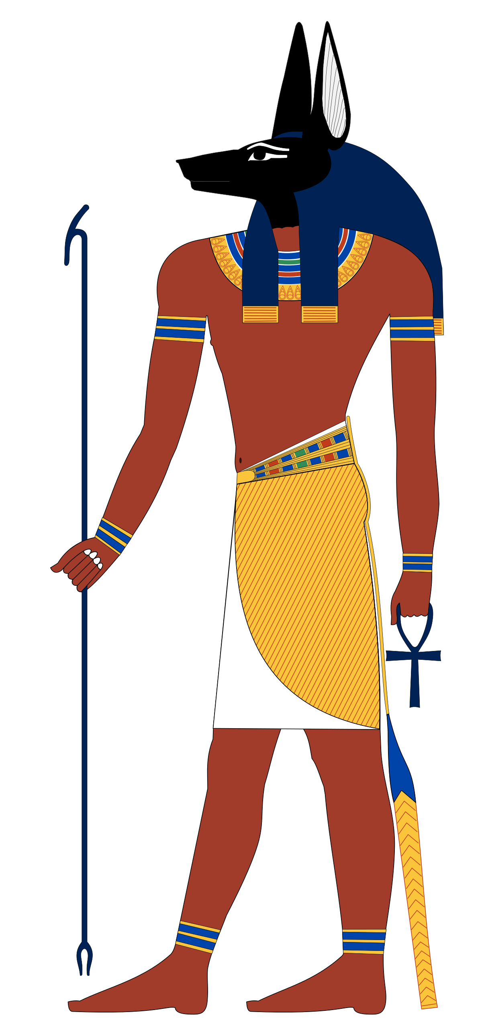
Oh no you accidently pressed a secret button on the statue and now the roof is coming down!!! Anubis is the god of the underworld, death, and mummification. What physical form does Anubis take?

Slide 11
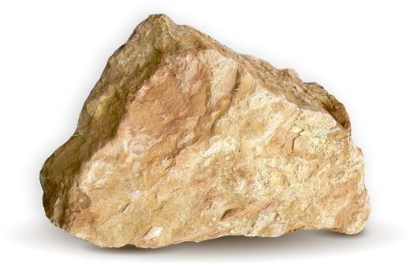
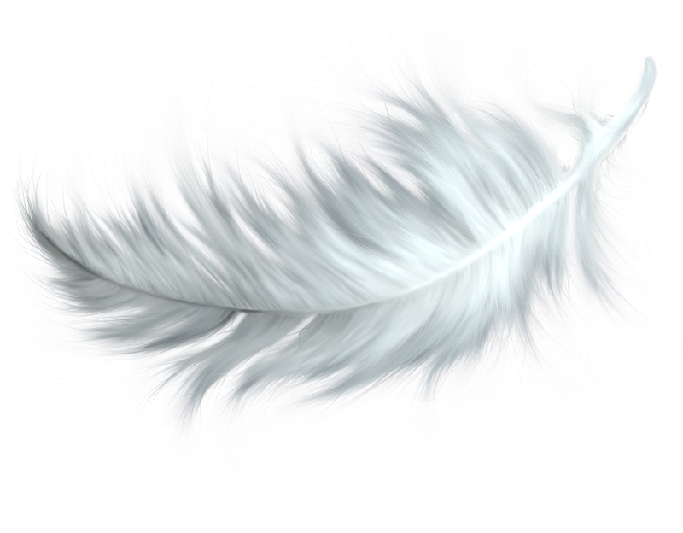
Sorry that answer is incorrect. The ceiling is coming down faster! Try another question.
Osiris overseas the weighing of the heart. What is the heart weighed against?

Slide 12
Wow! Looks like you found a secret ancient pathway. The statue moved and revealed a stairway.
Do you want to climb down it, or go back the way you came?

Slide 13
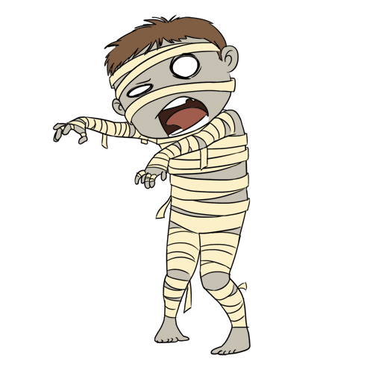
Oh no you have run into a mummy! Answer his question correctly and he will let you move on.
What was placed in the canopic jars during mummification?
Liver, intestines, lungs and stomach
Liver, brain, heart and stomach

Slide 14
Sorry! That answer was incorrect. He is going to give you one more chance…
True or false, the Egyptians also mummified animals?
True
False

Slide 15
What are you going to do now? There are so many paths to choose from!

Slide 16
That’s weird! Looks like it took us back here…. Maybe try a different one.

Slide 17
Good choice, it looks like this tunnel leads somewhere….

Slide 18
Hmm, this is a really long hallway.

Slide 19
It doesn’t seem to stop!

Slide 20
Looks like a dead end, just a wall. But wait… One of them is speaking!
Congratulations, you’re almost there! Answer 2 more questions correctly and you will find treasure beyond your wildest dreams…. Remember, get two wrong and it’s game over....

Slide 21
Wow there was a trap door and you fell down here.
Looks like a dead end, just a wall. But wait… One of them is speaking!
Congratulations, you’re almost there! Answer 2 more questions correctly and you will find treasure beyond your wildest dreams…. Remember, get two wrong and it’s game over....

Slide 22
How many ’assessor gods’ are said to judge if you have lived a righteous life?
3
42

Slide 23
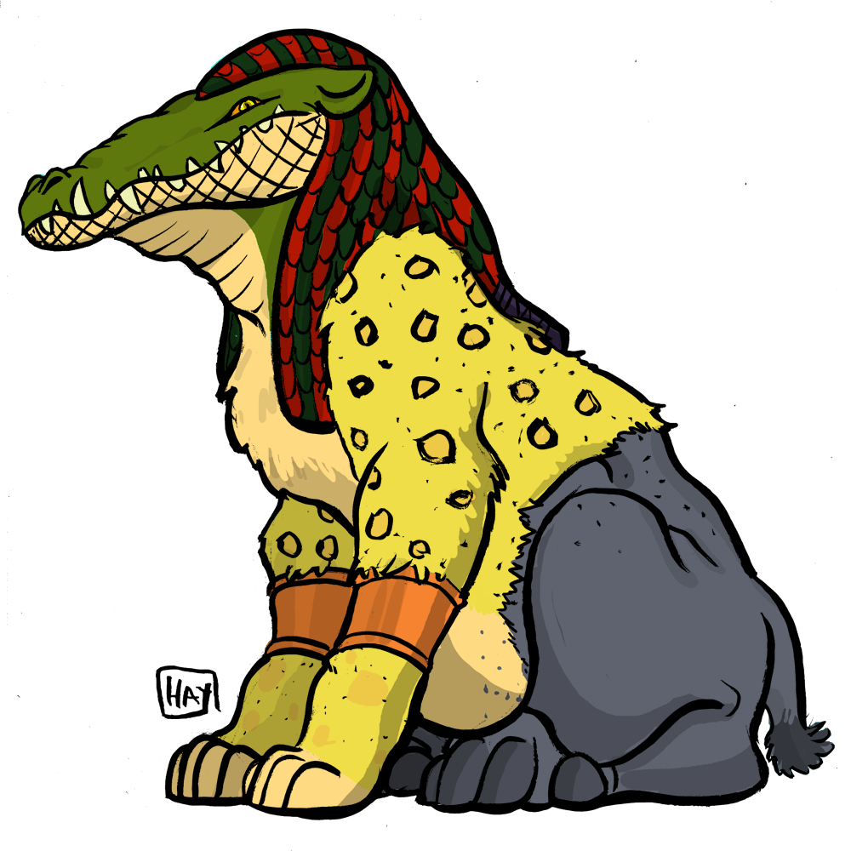
If your heart is heavier than the feather in the weighing of the heart, what happens?
It is devoured by Ammit.
Horus swoops in and takes it away.

Slide 24
If your heart is heavier than the feather in the weighing of the heart, what happens?
It is devoured by Ammit.
Horus swoops in and takes it away.

Slide 25
This is Ra, what is he the God of?
Crops
The Sun

Slide 26
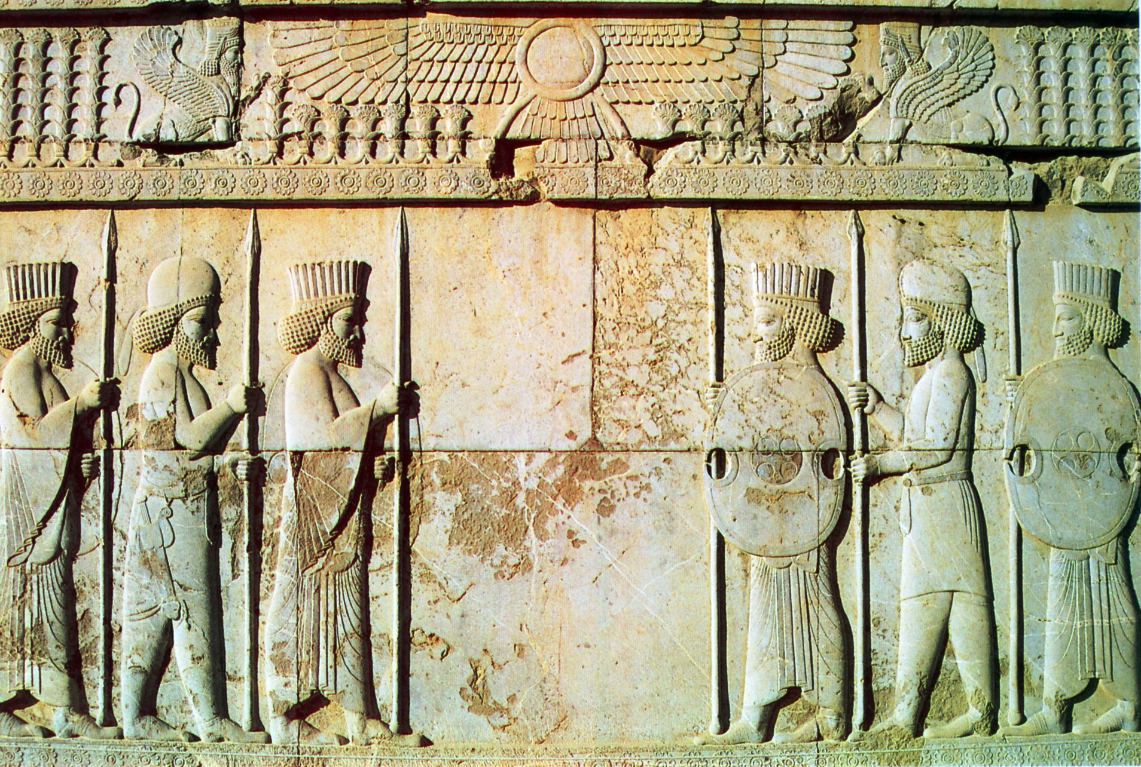
Congratulations, you have proven yourself worthy.
Congratulations!
You completed the quest
The treasure is yours to keep.

Slide 27
Wow this is incredible! I wonder where that door goes.

Slide 28
There is some ancient text on the door that says: Answer correctly and your path will appear.
Which Canopic jar contained the liver?

Slide 29
Sorry that answer was incorrect, try again.
Which Canopic jar contained the liver?

